Slide 1

BAN6420 - Module 6 Final Project Data Visualization Survey on Age, Gender & Spending Categories Chukwuemeka Vincent Masters of Science in Data Analytics Nexford University Raphael Wanjiku, PhD October 29, 2024

Slide 2

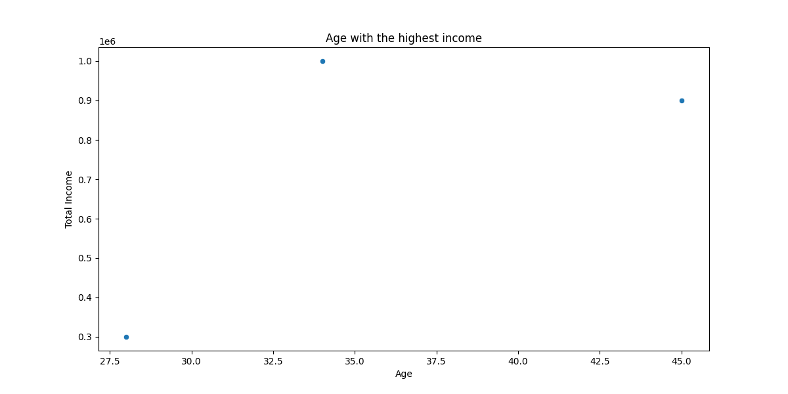

Slide 3
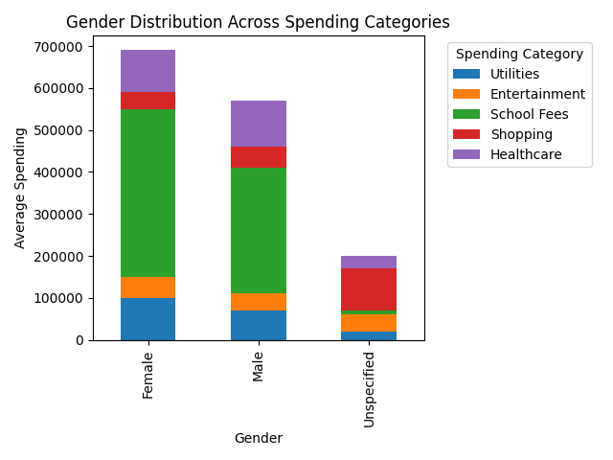

Slide 4
Conclusion
The above plotted diagrams give insights into the proportion of individual age brackets and total income earned. We also have the gender distribution across spending categories, which shows that the female gender spend the most. This in turn implies that male gender saves more by reducing their spending habit.

Slide 5
Reference
Flask. (2024). Welcome to Flask — Flask Documentation (3.0.x). Palletsprojects.com. https://flask.palletsprojects.com/en/stable/
Matplotlib. (2012). Matplotlib: Python plotting — Matplotlib 3.1.1 documentation. Matplotlib.org. https://matplotlib.org/
MongoDB. (n.d.). MongoDB Documentation. Https://Github.com/Mongodb/Docs-Bi-Connector/Blob/DOCSP-3279/Source/Index.txt. https://www.mongodb.com/docs/
Pandas. (2024). pandas documentation — pandas 1.0.1 documentation. Pandas.pydata.org. https://pandas.pydata.org/docs/

